Slide 1
Town of Hanson Override Forum
April 22, 2025

Slide 2
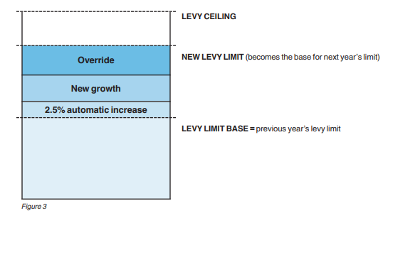
WHAT IS AN OVERRIDE?
The Town of Hanson is allowed to increase its tax levy by 2.5 % each year
The Tax Levy is the amount of taxes that the Town can assess and collect from Town residents
Any new taxable development can also increase the tax levy (New Growth)
Only the Town residents can Override the levy limit at an Annual Election

Slide 3
Town of Hanson Revenue sources
Taxation
Real Estate
Personal Property
State Aid
Chapter 70
Unrestricted General Government Aid
Local Program Reimbursements
Local Receipts
Motor Vehicle Excise
Meals Excise, Licenses, Permits, Fees, Investment Income
Other Financing Sources
Free Cash, Stabilization, Special Revenue Funds, Ambulance Receipts

Slide 4
Hanson Budget is funded predominantly by Property Taxes

Slide 5
Property Taxes are the Main Source of Revenue

Slide 6
The FY 2026 Proposed Budget by Category

Slide 7
The Override is asking for a $3 million increase in the Tax Levy
Allow the hiring of additional 4 Fire Fighters $344K
Allow for sustainable budget by eliminating the appropriation of $1.061 million from free cash (helps bond rating)
Avert the following reductions
$940K for WHRSD
$130K for Facilities Manager and IT
$160K Eliminate 1 Fulltime Police Officer and Firefighter
$216K Defer the purchase of 3 Police Cruisers
$73K Eliminate 1 FT Highway laborer and other expenses
$27K Reduction in Transfer Station hours
$49K Reductions in Health, COA, Library, and Parks and Fields

Slide 8
Hanson Override History

Slide 9
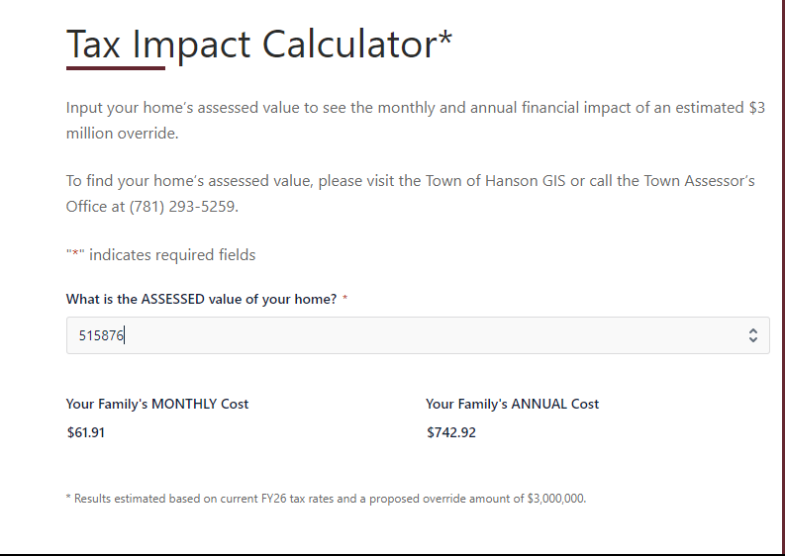
Resources for Information-HansonBudget.com
HansonBudget.com

Slide 10
What Happens Next?
Town meeting will vote on the FY 2026 budget on May 5,2025
Article 5 is a non-override budget and Article 6 is the budget with an override
Town Election is May 17, 2025

